Slide 1
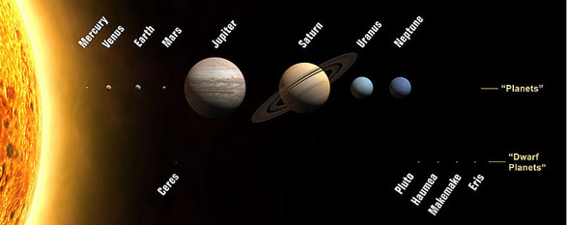
Geosciences of Dwarf Planets: Pluto Update!
Suzanne Metlay, Ph.D.
Western Governors University suzanne.metlay@wgu.edu
  Estes Park Memorial Observatory – 22 August 2015

Slide 2
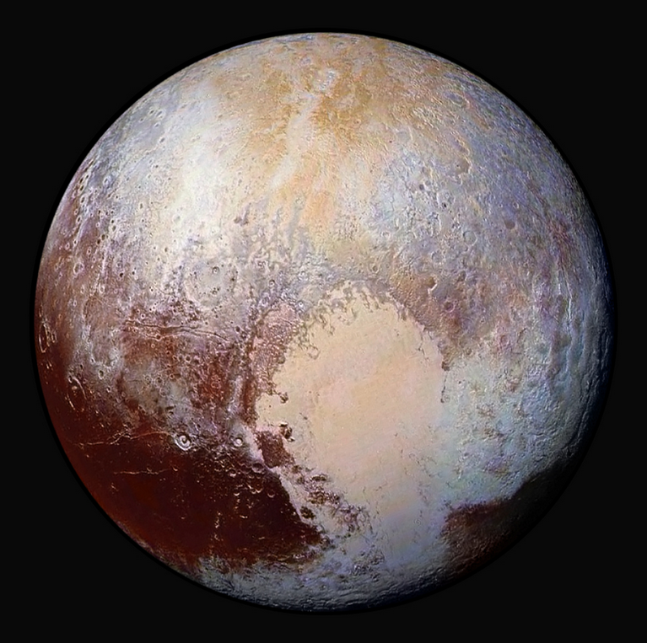
Pluto is Beautiful!
Enhanced Color Image
Credit:
NASA
Johns Hopkins University Applied Physics Laboratory
Southwest Research Institute
Enhanced = Data/Images from different cameras mixed together
Certain features “pop” as a result
Colors are real
Colors indicate chemical composition of ice or dust
Methane CH₄
Carbon Monoxide CO

Slide 3
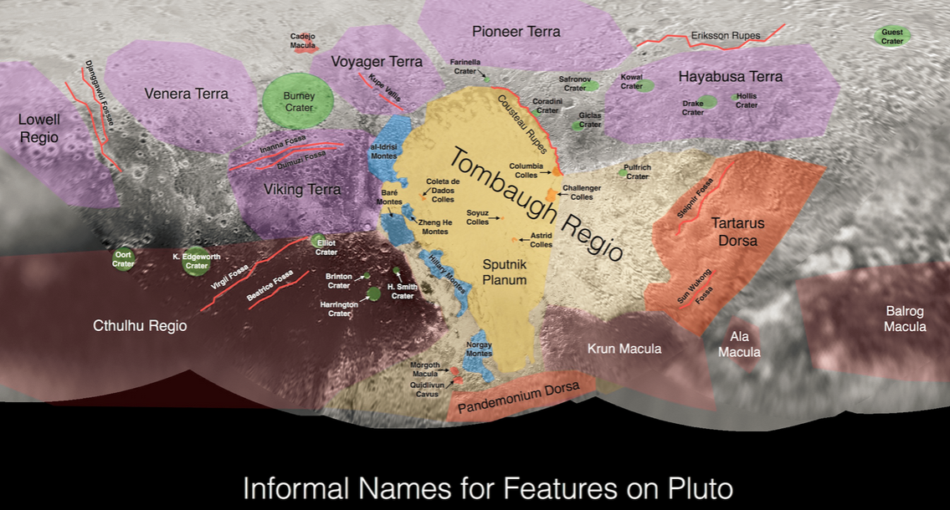
Proposed names for Pluto features

Slide 4
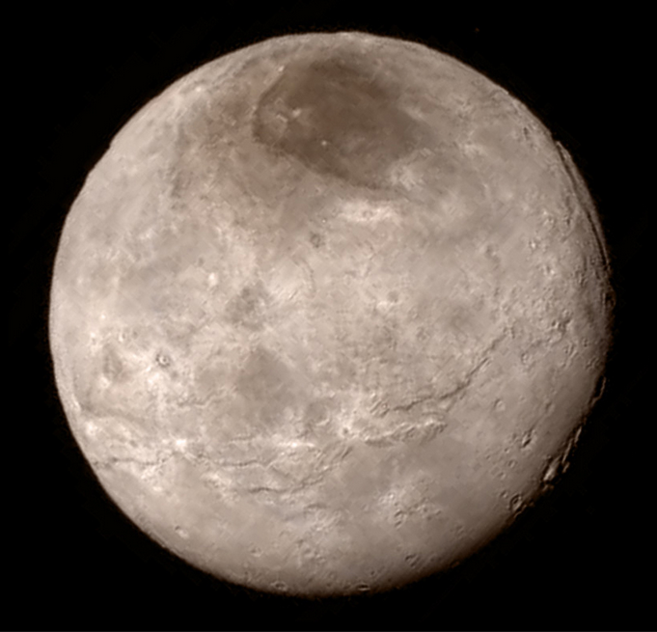
Charon is lovely too!
More images, videos, and explanations at:
http://space.io9.com/charon-you-are-a-glorious-beautiful-moon-1717979372

Slide 5
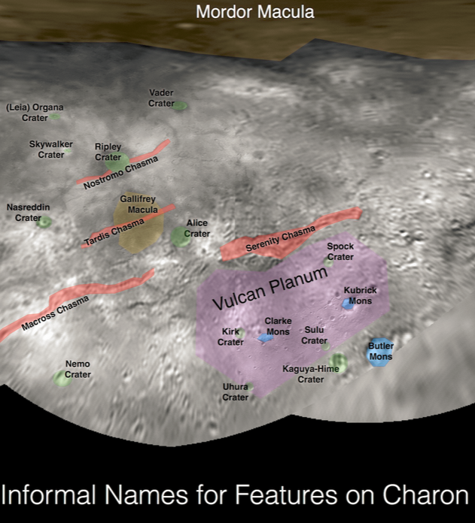
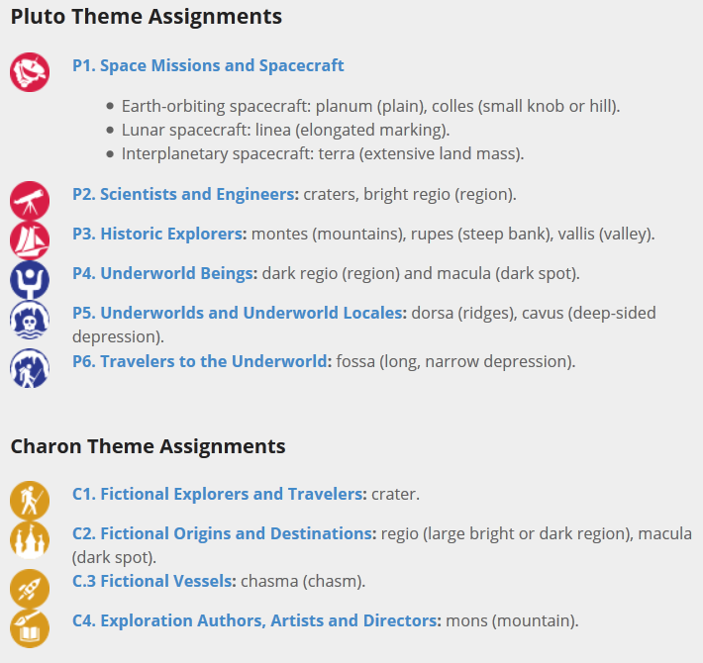
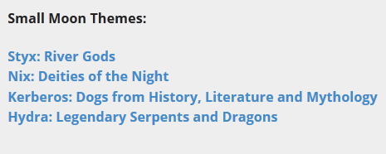
Proposed names for Charon features

Slide 6
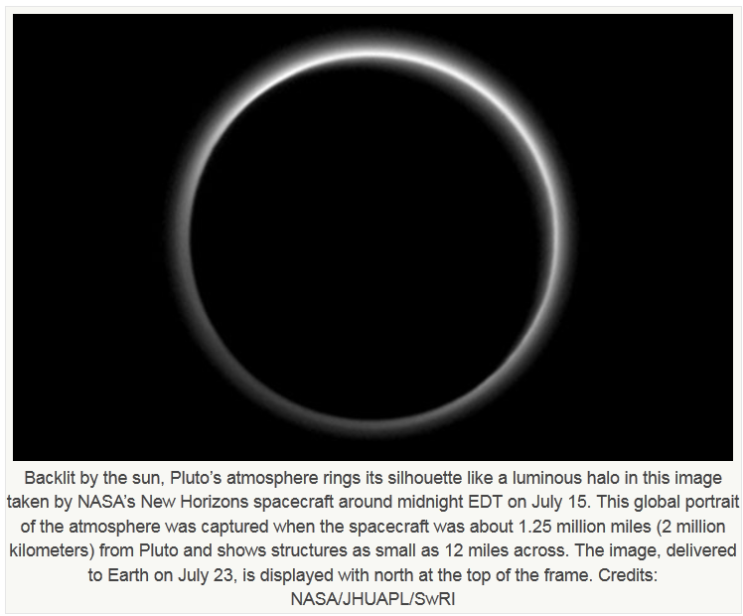
Pluto’s Nitrogen Atmosphere
Credit: http://scitechdaily.com/new-horizons-reveals-flowing-ices-exotic-surface-chemistry-mountains-and-haze-on-pluto/

Slide 7
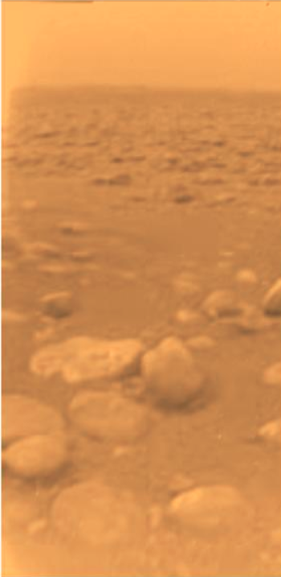
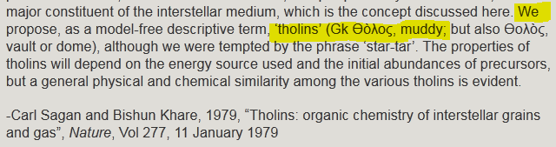
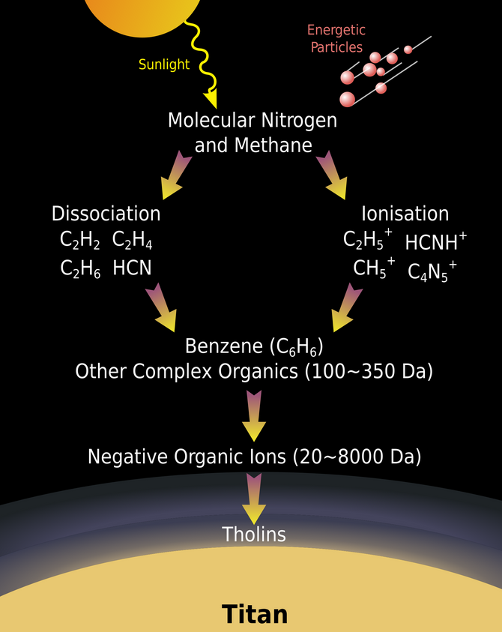
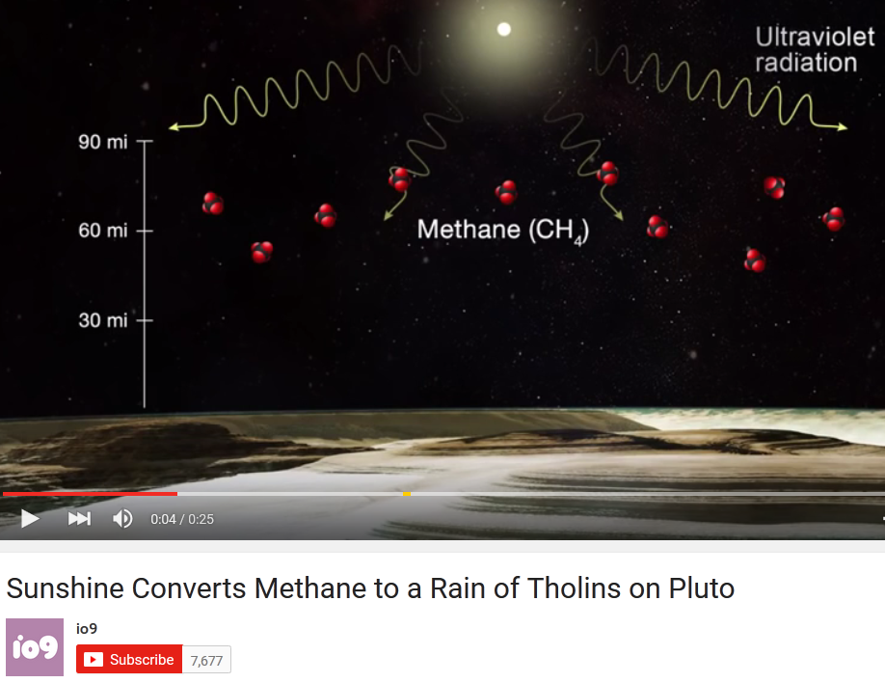
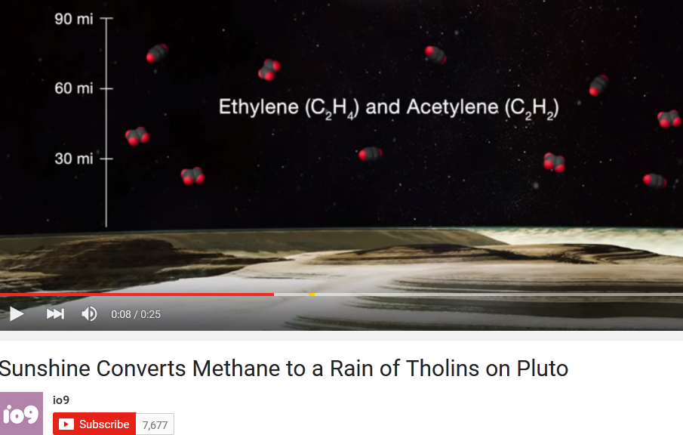
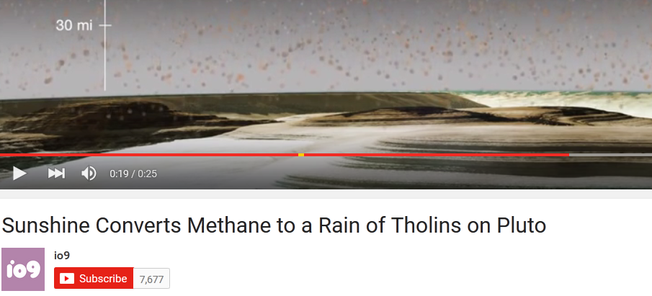
Why is Pluto Red? Tholins!
Titan, Saturn’s Moon
Credit: Huygens Lander, ESA

Slide 8
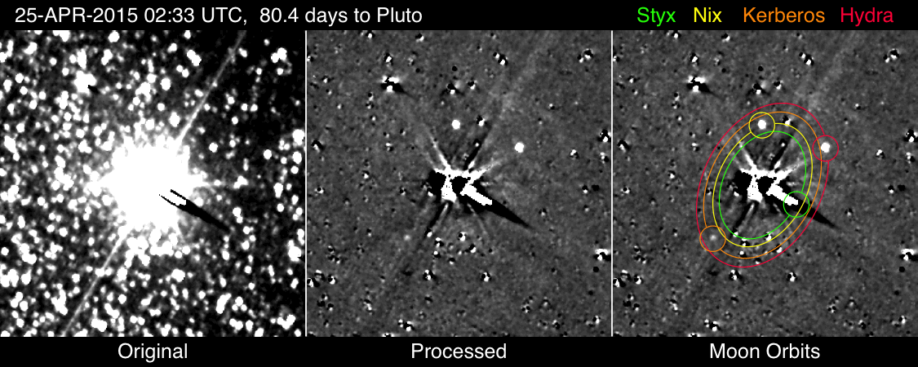
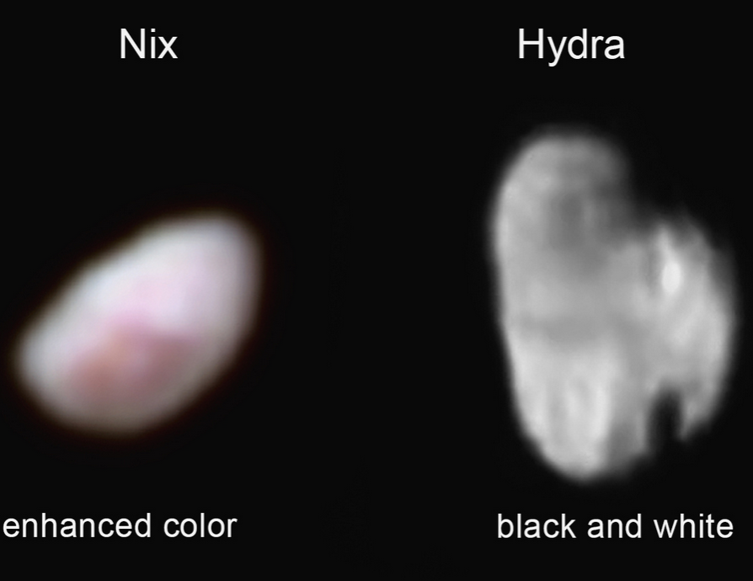
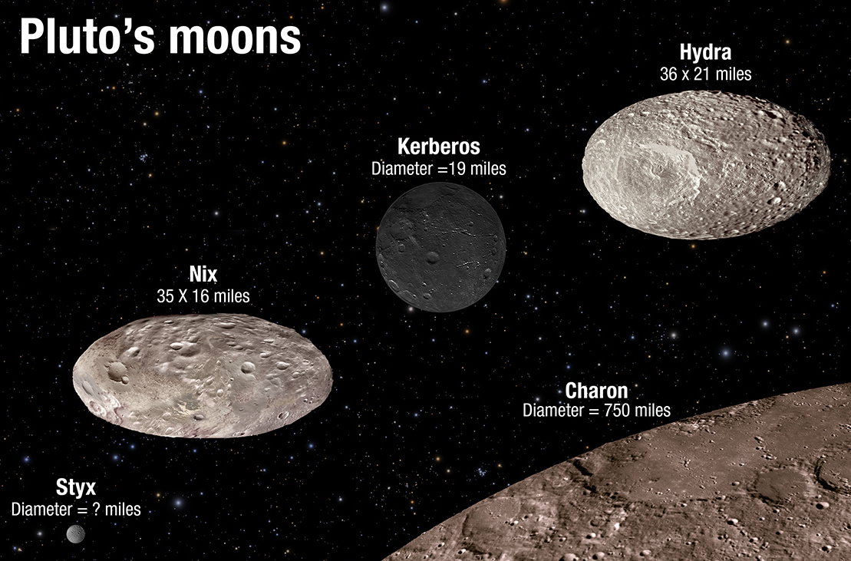
Pluto’s Small Moons
5 Moons: Charon is the largest
  Center of mass of Pluto system is
  between Pluto and Charon
    Turbulent orbits for smaller moons
  Smaller moons are egg-shaped
  Kerberos is unusually dark
http://www.nasa.gov/content/goddard/briefing-materials-observations-of-pluto-s-moons

Slide 9
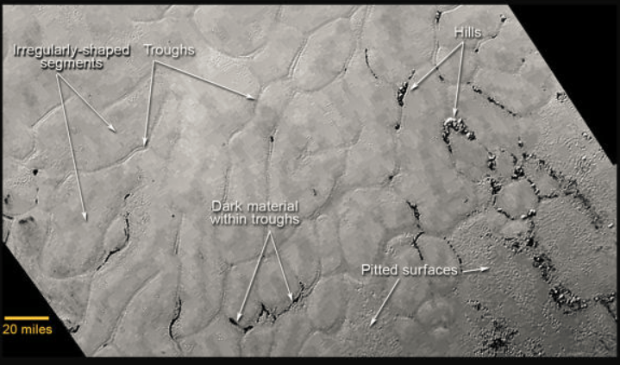
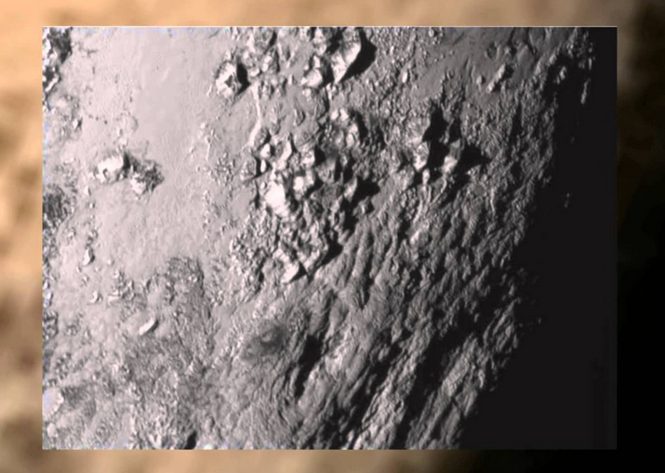
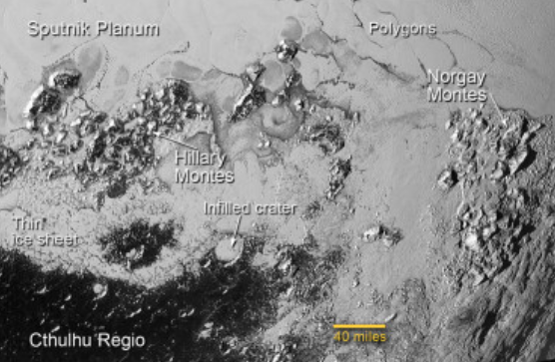
Pluto’s Icy Plains & Mountain Ranges
It’s OK to be Smart Pluto episode:
https://www.youtube.com/watch?v=WwRvWMRUhKE
SciShow Pluto Episode:
https://www.youtube.com/watch?v=SeIyO1J2rnA

Slide 10
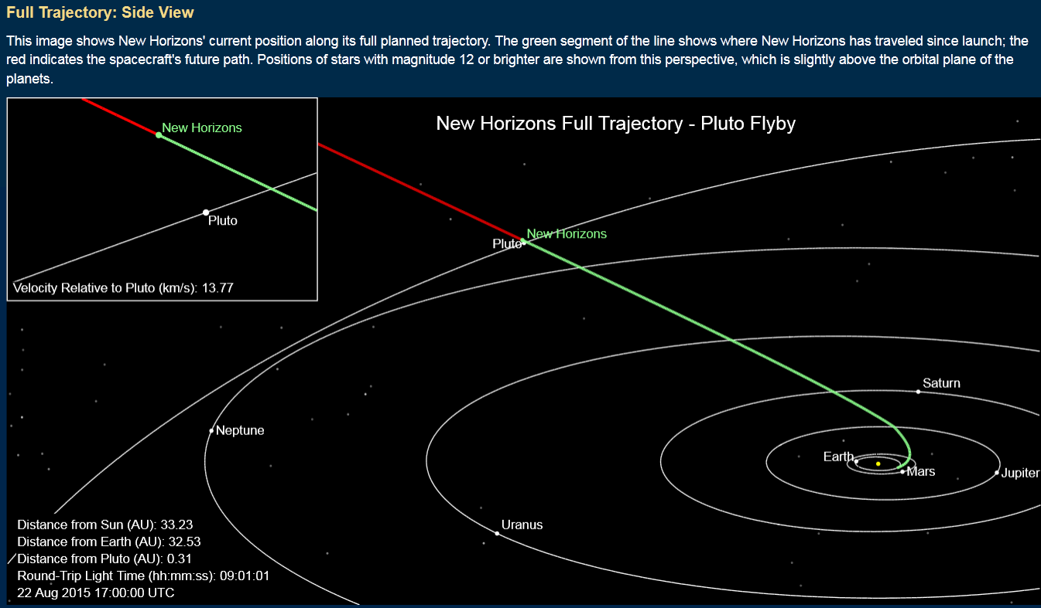
Where is New Horizons now?
Traveling through Kuiper Belt at velocity of 1.2 million kilometers/day
About 740,000 miles/day
Next set of images to be downloaded and released to public in mid-September
http://pluto.jhuapl.edu/Mission/Where-is-New-Horizons/index.php

Slide 11

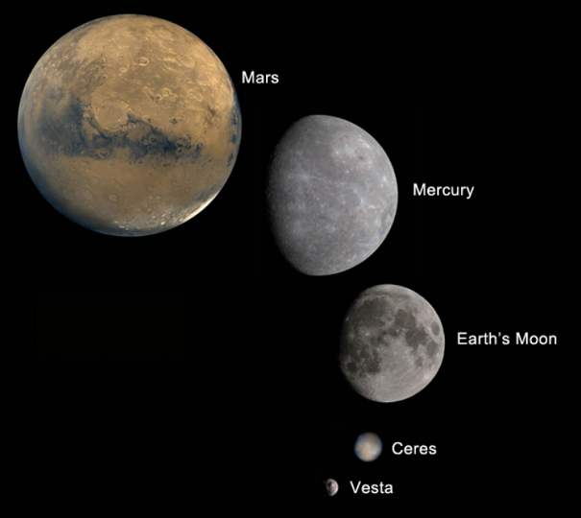
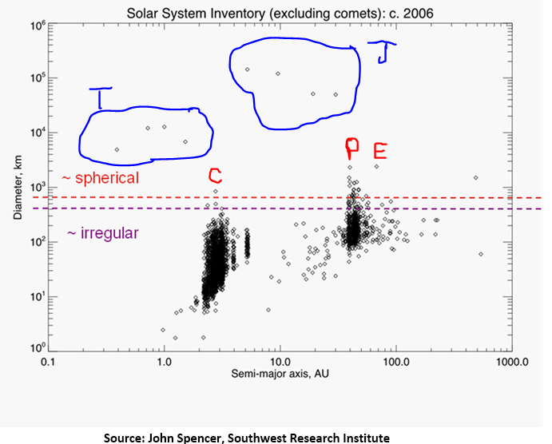
Solar System Structure: Can You Spot The Planets?
Data from John Spencer, Southwest Research Institute
Credits: NASA/JPL & Caltech/UCLA
Peter Dinklage, Jerome Flynn,
Daniel Portman in Game of Thrones
Photo Credit: Keith Bernstein-HBO

Slide 12
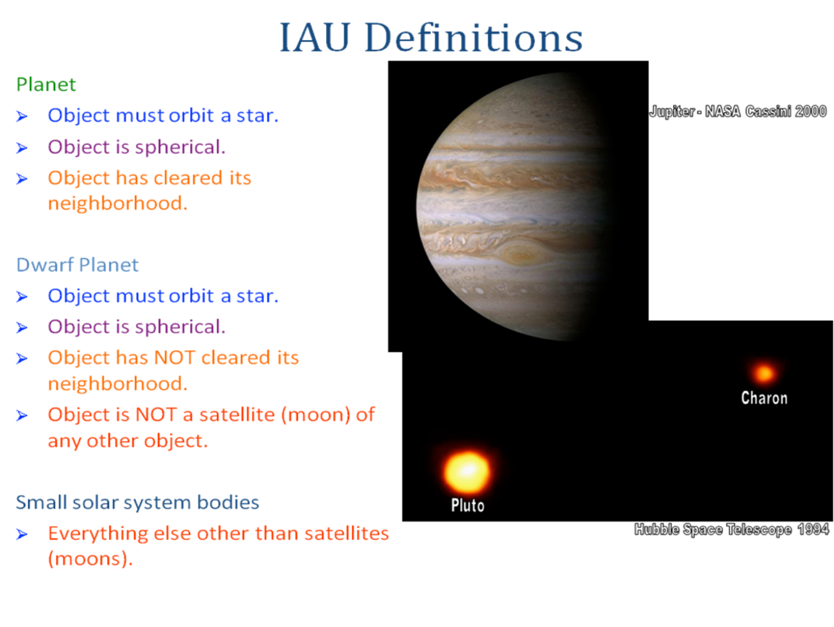
Definition: Planet vs Dwarf Planet

Slide 13
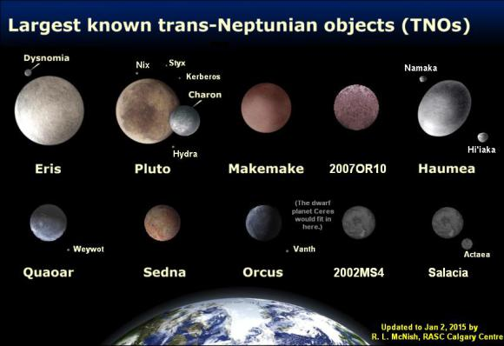
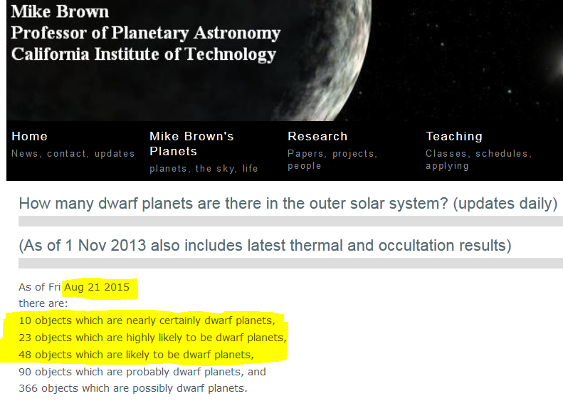
Known Dwarf Planets
Dwarf Planets may have:
Moons
Atmospheres
Surface processes
Surprises?

Slide 14
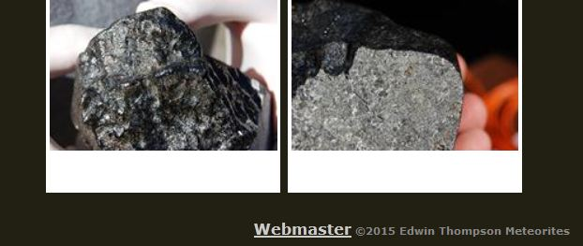
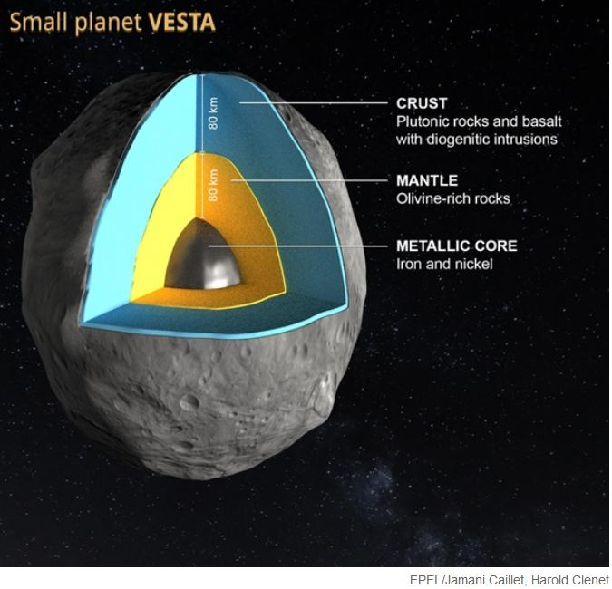
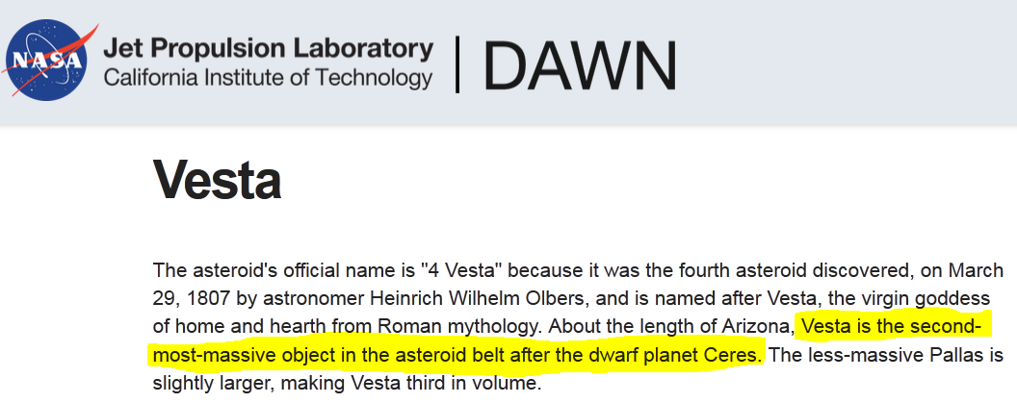

What about Vesta? Berthoud Meteorite
Berthoud Meteorite
Discovered in 2004 as a “fresh fall”
Identified as a monomict breccia eucrite
Verified as a piece of Vesta
What is Vesta?

Slide 15
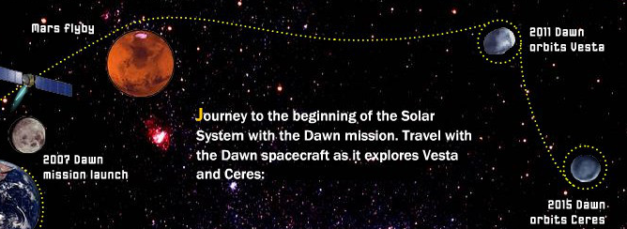
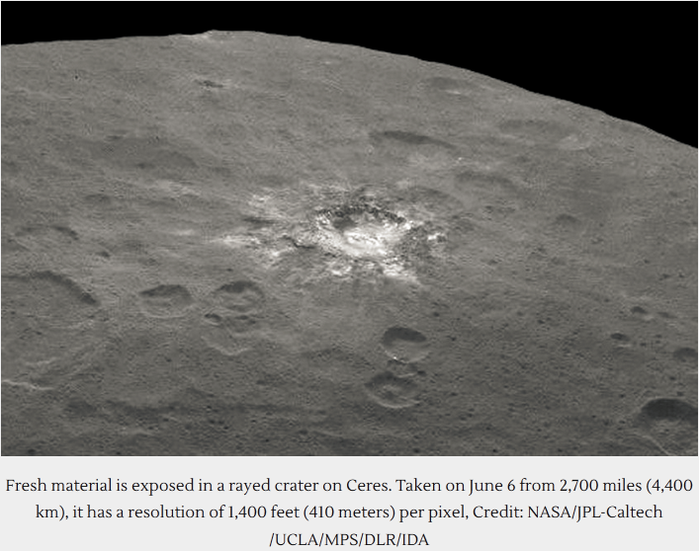
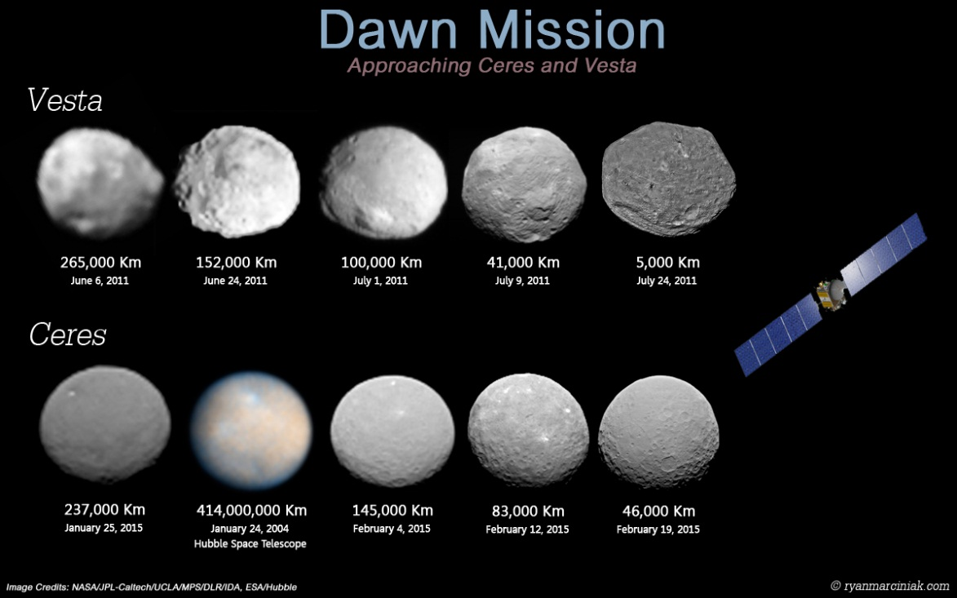
DAWN Mission to Vesta & Ceres: 2007-Now!
Dec. 2015:
Low altitude (375 km) mapping of Ceres
DAWN will become a permanent satellite of Ceres

Slide 16
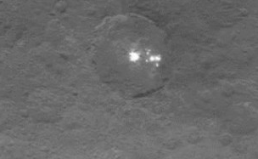
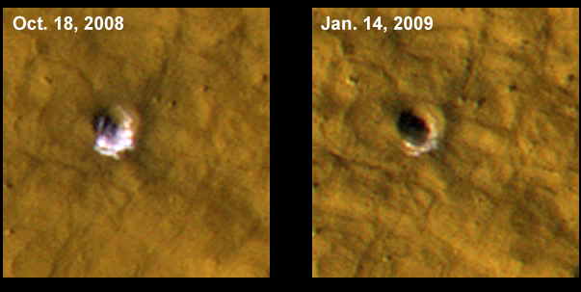
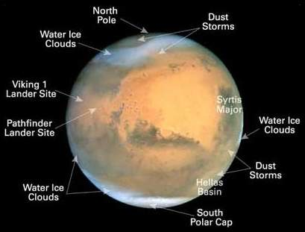
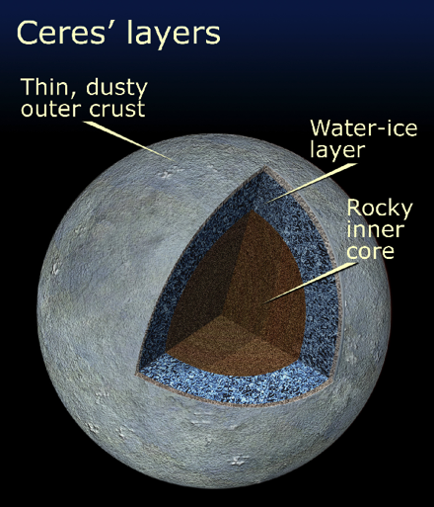
Spots on Ceres: Ice?
Ice exposed by recent impact, then evaporated over several weeks
NASA Mars Reconnaissance Orbiter
http://www.jpl.nasa.gov/images/mro/20090924/mars_ice
Credit: NASA/JPL-Caltech/UCLA/MPS/DLR/IDA
Where did the spots on Ceres come from?
Comet residue?
Subsurface ice revealed by impact?
Salt deposits?
Cryosphere = Ice
Caps, glaciers
Hydrosphere = Liquid water
Subsurface or on surface
Oceans or running water
Credit: NASA/ESA/STScI

Slide 17

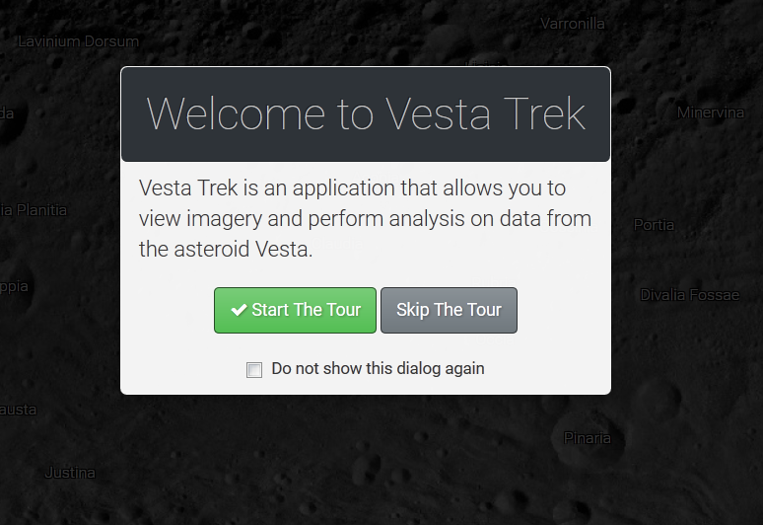
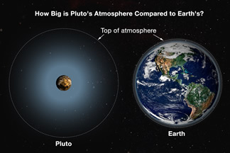
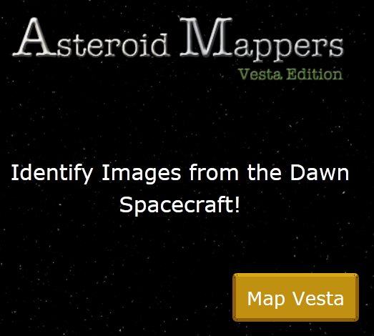
Dwarf Planets are Little Worlds!
Dwarf Planets have layers just like Planets!
Density Differentiation and Gravity-Induced Sphericity → Layers + Round = (Dwarf) Planet
We can explore these worlds ourselves:
http://vestatrek.jpl.nasa.gov/
https://cosmoquest.org/educatorszone/
Dwarf Planets have geosciences: solid rock surfaces, gas atmospheres, maybe liquids & ice
Join the Citizen Science mapping brigade!
Keep watching for NASA news!

Slide 18
References
Asteroid Mappers, Vesta Edition (2015). Retrieved from CosmoQuest website at: https://cosmoquest.org/educatorszone/
Bernstein, K. (2013). Image of Peter Dinklage, Jerome Flynn, and Daniel Portman. Retrieved from Artsbeat blog, New York Times, at: http://artsbeat.blogs.nytimes.com/2013/03/22/taking-questions-for-game-of-thrones-creators/?_r=0
Brown, M. (2015). How Many Dwarf Planets are There in the Outer Solar System? Retrieved from Mike Brown’s Homepage, Caltech website, at: http://web.gps.caltech.edu/~mbrown/dps.html
Brown, M. (2015). Ten Years of Eris. Retrieved from Mike Brown’s Homepage, Caltech website, at: http://www.mikebrownsplanets.com/2015/01/ten-years-of-eris.html
EPFL (2015). Asteroid Vesta to reshape theories of planetary formation. Retrieved from Astronomy magazine website at: http://www.astronomy.com/news/2014/07/asteroid-vesta-to-reshape-theories-of-planet-formation
Informal Names for the features of Pluto and Charon (2015). Retrieved from SETI Institute website at: http://www.ourpluto.org/maps
Io9 (2015). Sunshine Converts Methane to Tholin Rain on Pluto. Retrieved from Io9.com’s YouTube page at: https://www.youtube.com/watch?v=ZDAqABS_MEc
King, B. (2015). Ceres has Lots of Bright Spots. Retrieved from UniverseToday.com website at: http://www.universetoday.com/120897/ceres-has-lots-of-bright-spots/
Lakdawalla, E. (2015). What’s Up in the Solar System: August 2015 Edition. Retrieved from Planetary Society website at: http://www.planetary.org/blogs/emily-lakdawalla/2015/08101604-whats-up-in-solar-system.html
Meteoritical Bulletin (2008; revised 2012). Berthoud Meteorite. MB Number 94. Retrieved from Lunar & Planetary Institute website at: http://www.lpi.usra.edu/meteor/metbull.php?code=47355
NASA (2015). Dawn Mission images and diagrams of Ceres. Retrieved from Dawn Mission website, Jet Propulsion Lab, NASA at: http://dawn.jpl.nasa.gov/
NASA (2009). Mars Reconnaissance Orbiter images of Mars. Retrieved from MRO Mission website, Jet Propulsion Lab, NASA at: http://www.jpl.nasa.gov/images/mro/20090924/mars_ice
NASA (2015). New Horizons Mission images and diagrams of Pluto system. Retrieved from NASA Goddard Spaceflight Center website at: http://www.nasa.gov/content/goddard/briefing-materials-observations-of-pluto-s-moons
New Horizons Reveals Flowing Ices, Exotic Surface Chemistry, Mountains, and Haze on Pluto (2015). Retrieved from SciTechDaily website at: http://scitechdaily.com/new-horizons-reveals-flowing-ices-exotic-surface-chemistry-mountains-and-haze-on-pluto/
New Horizons Spots Pluto’s Faintest Known Moons (2015). Retrieved from New Horizons Mission website, Johns Hopkins University Applied Physics Lab, at:
http://pluto.jhuapl.edu/News-Center/News-Article.php?page=20150512
Sagan, C. & Khare, B. (1979), quoted in Horst, S. (2015). What in the World(s) are Tholins? Retrieved from Planetary Society website at http://www.planetary.org/blogs/guest-blogs/2015/0722-what-in-the-worlds-are-tholins.html
Showalter, N. (2015). Telling Pluto’s Story, One Fragment at a Time. Retrieved from Planetary Society website at: http://www.planetary.org/blogs/guest-blogs/2015/0611-telling-plutos-story.html
Singer, K. (2015). Atmospheric Escape and Flowing N2 Ice Glaciers – What Resupplies Pluto’s Nitrogen? Retrieved from NASA website at: https://blogs.nasa.gov/pluto/2015/08/10/atmospheric-escape-and-flowing-n2-ice-glaciers-what-resupplies-plutos-nitrogen/
Spencer, J. (2006). Solar System Inventory. Retrieved from AST 101 Lecture Notes, Week 4 – Solar System Formation, Suzanne Metlay, 2012. Personal collection.
Summers, M. (2015). Science Shorts: How Big is Pluto’s Atmosphere? Retrieved from New Horizons Mission website, Johns Hopkins University Applied Physics Lab, at: http://pluto.jhuapl.edu/News-Center/Science-Shorts.php?page=ScienceShorts_02_24_2015
Thompson, E. (2015). Berthoud Meteorite. Retrieved from E.T. Meteorites website at: http://www.etmeteorites.com/meteoritesforsale/berthoudeucrite.html
Vesta Trek (2015). Retrieved from NASA website at: http://vestatrek.jpl.nasa.gov/

Slide 19
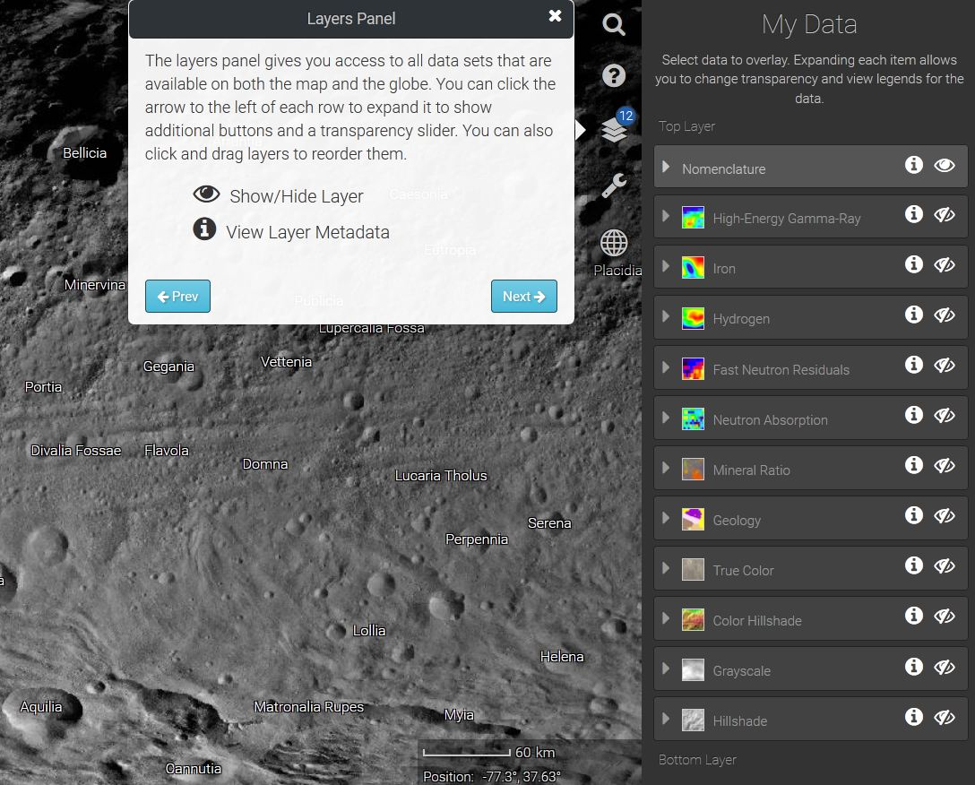
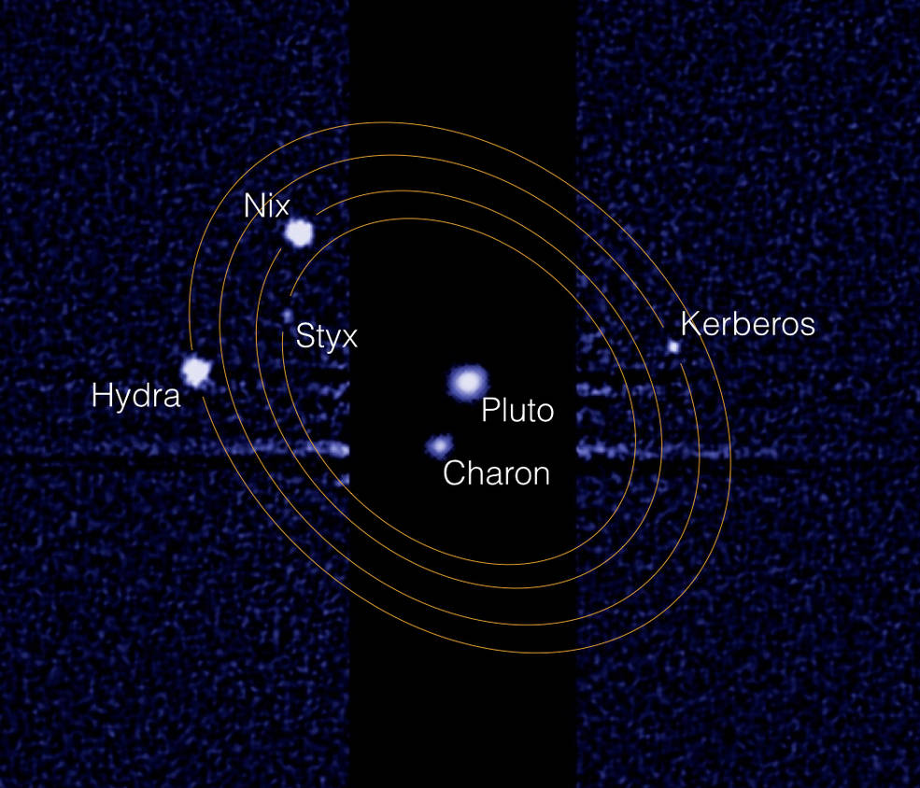
Thank You, EPMO!
Contact me at:
Suzanne Metlay, Ph.D.
Teacher Education: Geosciences
Western Governors University
suzanne.metlay@wgu.edu
Let’s go play with:
http://vestatrek.jpl.nasa.gov/
http://www.nasa.gov/content/goddard/briefing-materials-observations-of-pluto-s-moons

